Slide 1

ANNAMACHARYA PG COLLEGE OF COMPUTER STUDIES
ONLINE E-LEARN AND EARN
UNDER THE GUIDANCE
OF
SUDHEER BABU SIR
Assistant Professor,
MCA Department.
Presented by
G.RATHNAKISHOR ROLLNO: 185N5F0021, MCA VI Semester, APGCCS, Rajampet

Slide 2
CONTENTS
INTRODUCTION
PURPOSE
SCOPE
NEED FOR SYSTEM
SOFTWARE REQUIREMENT ANALYSIS AND SPECIFICATION
PRODUCT PERSPECTIVE
PRODUCT FUNCTIONS
USER CONSTRAINTS
HARDWARE REQUIREMENTS
SOFTWARE REQUIREMENTS
NON-FUNCTIONAL REQUIREMENTS
SDLC

Slide 3
INTRODUCTION
This Project is an Online Education website.
This Project provides creation of CBT (computer base tutor) with web pages, audio and video facilities.
It help our clients to educate their workforce and increase their productivity and performance, through low cost creating CBT’s using online packages, which provides e-Learning.
This provide a login for users who wants to create a CBT, with click and drag options the users can create required CBT’S providing education and examination.
This project is used for the students aspiring to be high class professional.
Constant personalization of candidate learning process and frequently interacting with the online expert give e-Learn subscriber an edge over other students.
This approach to e-Learning is delivered by unifying on-line learning, web-based training and automatic CBT creations.

Slide 4
PURPOSE
In this system, our main purpose is to reduce the user interaction with different applications. The main goals are as follows:
Providing an online education website for students
Providing course learning through online.
Providing examinations online and the certification online.

Slide 5
SCOPE
Constant personalization of candidate learning process and frequently interacting with the online expert give e-Learn subscriber an edge over other students.
It help our clients to educate their workforce and increase their productivity and performance, through low cost creating CBT’s using online packages, which provides e-Learning.

Slide 6
NEED FOR SYSTEM
Existing System
It is not an online system there is no candidate learning process. It does not provide any references about previous missed classes.

Slide 7
Dis Advantages
It is high expensive process.
This process is time consume process .
Does not provide appropriate messages indicating errors or instructions.

Slide 8
Proposed System
The proposed system is a central repository where deployment of software and course portal study data is done. All clients present in the intranet contact the server to download the latest updates in software and study material etc.

Slide 9
Advantages
Provide appropriate messages indicating errors or instructions
Navigation is simple
Similar pattern of design in all screens
Accept various parameters incase of reports
Presentable format
No complexities

Slide 10
PRODUCT PERSPECTIVE
This system provides an easy way of storing all the business details at a centralised location with proper security .
This system also provides an easy way of user management , setting different access roles to users and changing the passwords of the user.

Slide 11
PRODUCT FUNCTIONS
Administrator
Student
Banker
Faculty
ADMINISTRATOR
Administrator maintains entire web site
Adds new courses, enables and disable courses
Uploads notes, courses and set permissions to various users
Set examinations papers
Conducts Examinations
Mailing Communication
Reports

Slide 12
STUDENT
These users Join on Self Interest directly .
Selection of Courses can be done.
Payment of fee through e-banking/DD etc. can be done.
Pay the fee to get login Id/password.
Learn course, write exam and get certificate
Mailing Communications

Slide 13
BANKER
Receives payment of users and communicate to the admin .
Received payments are sent to admin for giving acceptance to the course.
Provides detailed reports of all payments made by students.

Slide 14
FACULTY
Joins on Self Interest directly
Conduct classes & Clarify students doubts
Mailing Communications to members.

Slide 15
USER CONSTRATINS
The system should be available and the Users can use the system from their respective locations.
For gaining entry into the system the users should be registered and should be able use login & passwords for gaining access to the system.
The system should be able to accept more number of users.
The system should be easy to understand and organized in a structured way.
There should be no limitation about the hardware platform that is to be used to run the system.
Only admin is having super user permissions to do any kind of activity.

Slide 16
Hardware Requirements
Processing System : Intel I3 Processor / More
Hard Disk : 1 TB
RAM : 4 GB

Slide 17
Software Requirements
Operating system : Windows 7
Coding Language : Java 7.0
Web Server : Tomcat
Database : MYSQL

Slide 18
NON FUNCTIONAL REQUIREMENTS
Reliability
Security
Portability
Scalability

Slide 19
SDLC(software development life cycle) Water Fall Model
The waterfall model is a sequential design process, used in software development processes, in which progress is seen as flowing steadily downwards (like a waterfall) through the phases of conception, initiation, analysis, design, construction, testing, production/implementation and maintenance.

Slide 20
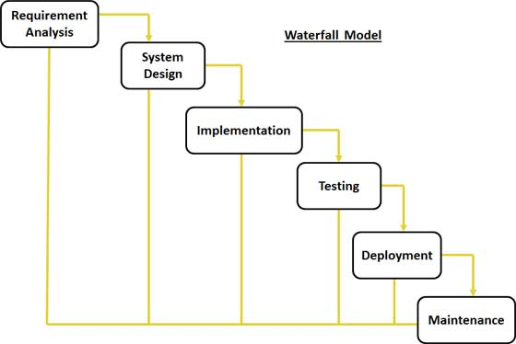
SDLC diagram

Slide 21
ANY QUIRES

Slide 22
THANK YOU

